Slide 1

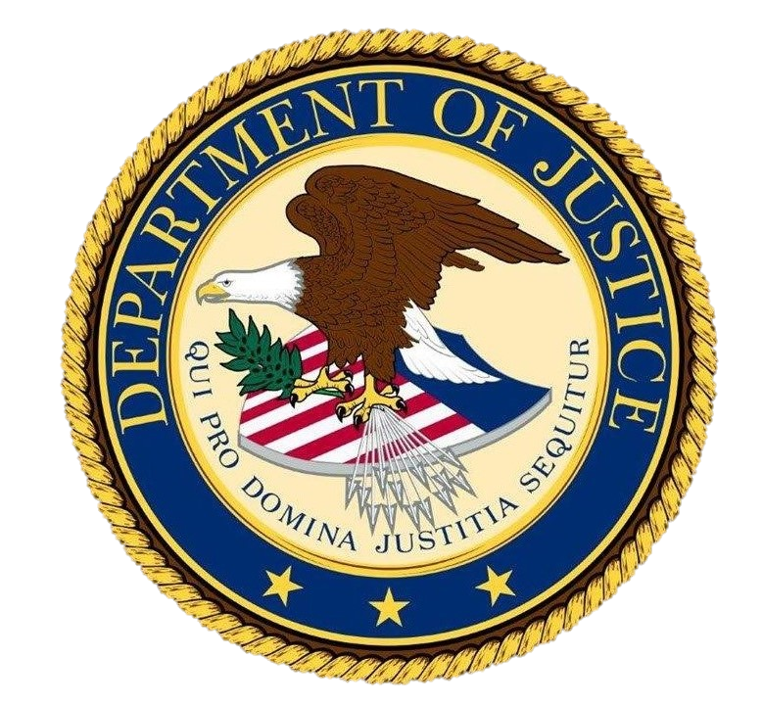
Setting Multiple Snares for Wildlife Criminals
Sylvia Shweder
Regional Resident Legal Advisor for CWT,
U.S. Department of Justice, OPDAT

Slide 2
Regional Resident Legal Advisor (CWT)
Training and Workshops
      Focus on prosecuting leaders of criminal organizations
Regional and international cooperation
Legislative Review
Case-Based Mentoring
Develop Standard Operating Procedures

Slide 3
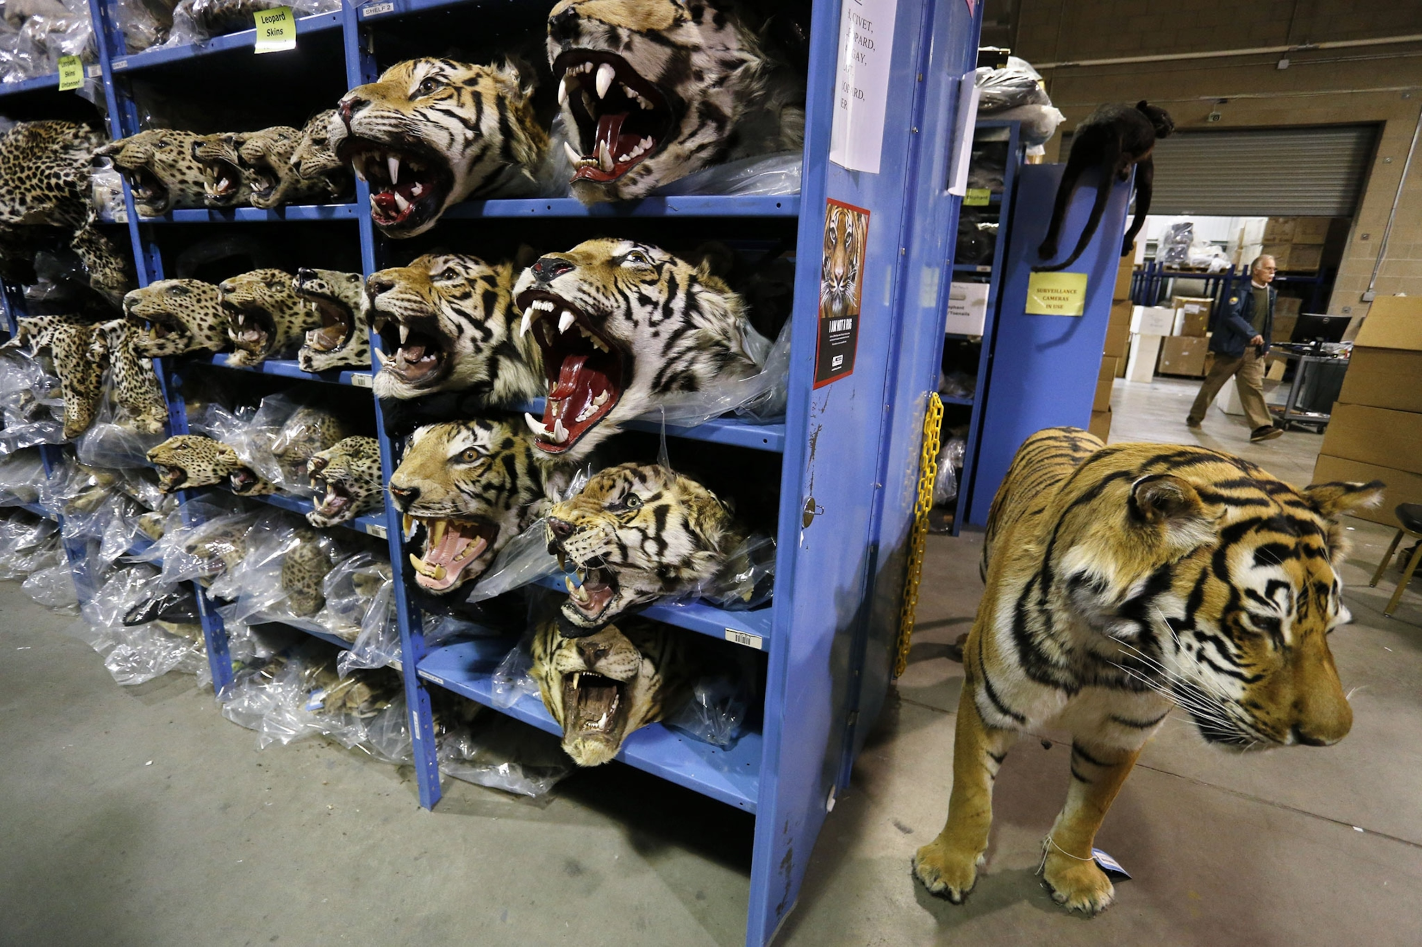
Prosecuting Wildlife Trafficking
Wildlife Trafficking Laws
Customs
Public corruption
Tax Evasion
Fraud
Narcotics
Weapons
Human trafficking/forced labor
Money Laundering
PHOTOGRAPH BY BRENNAN LINSLEY, AP
Notes:
These illegally trafficked leopard and tiger heads make up one of the macabre sights at the National Eagle and Wildlife Property Repository, a warehouse in Denver, Colorado, that houses illegal wildlife products.
PHOTOGRAPH BY BRENNAN LINSLEY, AP

Slide 4

Using Non-Wildlife Laws
Advantages
Judges, prosecutors more familiar with other crimes
Shows “serious” crimes involved
May have higher potential sentences
  Even with same conduct
Helps to prove wildlife crime
Asset forfeiture/seizures easier
May make extradition possible

Slide 5

Economic Crimes Often Involved
Characteristics of Economic Crime
High profit margin
Evidence traceable through financial institutions
  No victim to come forward
  Often crosses borders
    Follow the money using mutual legal assistance
    Work with other agencies
Hierarchical criminal organization
  Bottom of organization does not earn much

Slide 6
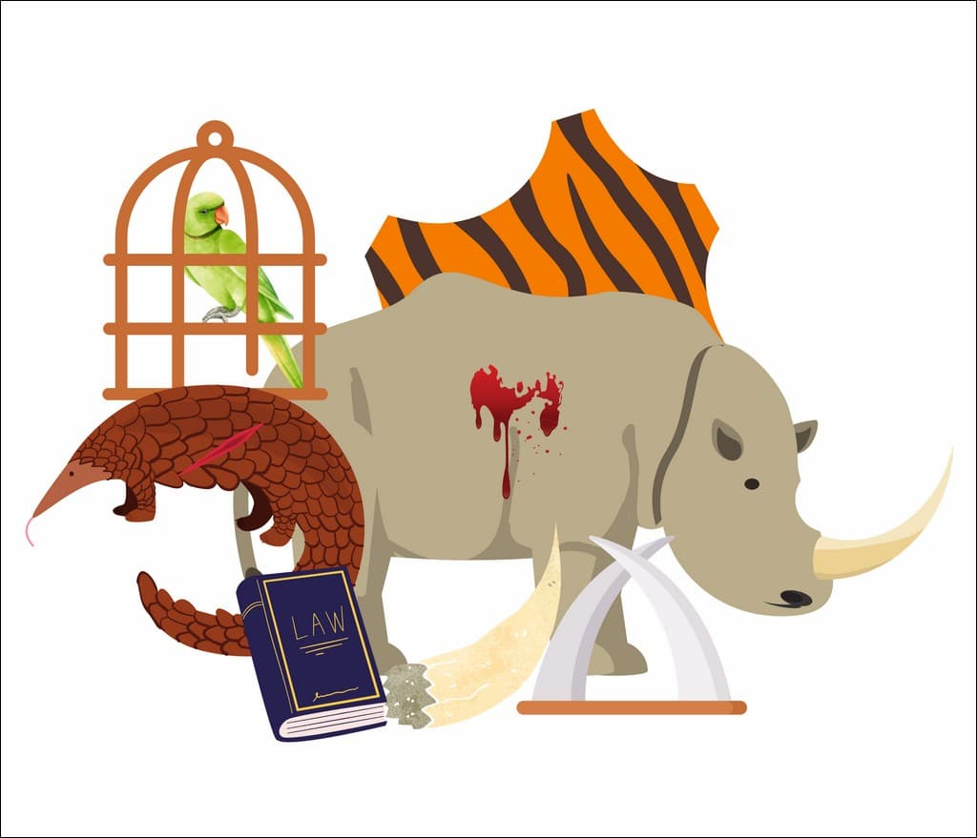
Wildlife Crime = Economic Crime
Usually committed for profit
Can involve organized crime, corruption
Theft of shared public resource
  Lose biosecurity, biodiversity, habitat
  Risk wildlife extinction
  Harm legitimate import/export businesses
Silent victim – can’t report
Notes:
Image: https://www.wildlifeconservationtrust.org/wp-content/uploads/2023/07/070323-Wildlife-Crime-and-Punishment-5.jpg

Slide 7
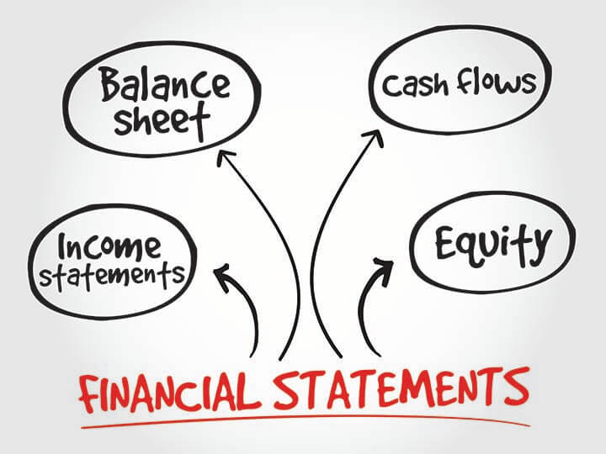
Financial Profile Explains Subject
Who are they, who are they dealing with, transactions on specific dates and times
Assets: Bank records, wire transfers, property, cars, jewelry
Financial liabilities

Slide 8
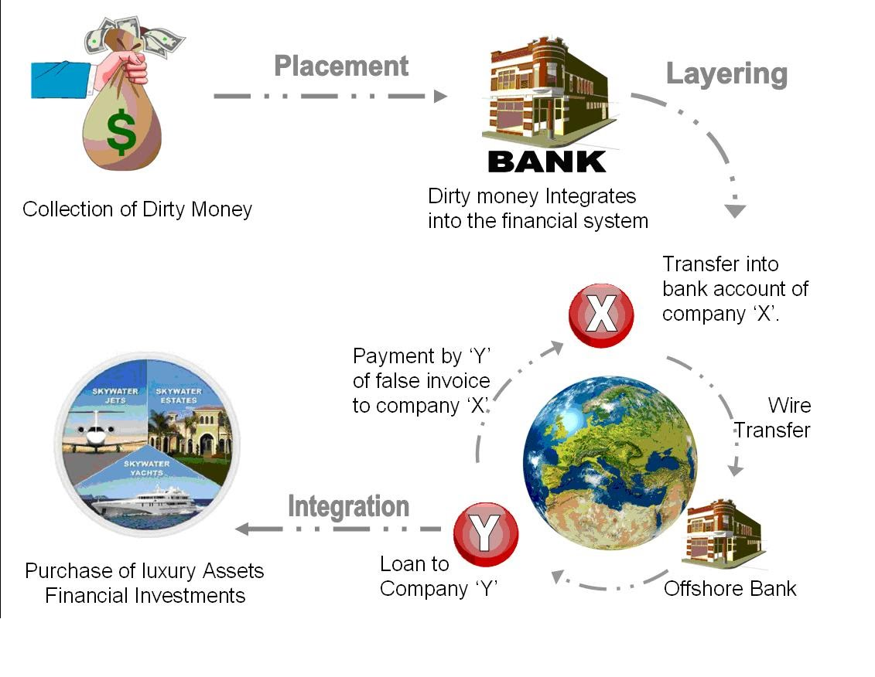
Money Laundering Steps
Consolidation

Slide 9
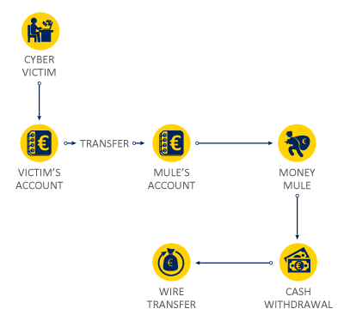
How Criminals Move Money
Stocks, bonds, investments
Loans
Gifts
Charities, casinos
Banks, financial institutions, money service business
Bulk cash smuggling
Hawalas
Trade-based money laundering

Slide 10
Trade-based Money Laundering
Trends/Red Flags
Payment for goods exceeds known market value
Payment for goods below known market value
Discrepancies on shipping documents
Products or options do not correspond with line of business
Shipment purchased by firms or individuals from foreign countries (other than country of stated end user)

Slide 11
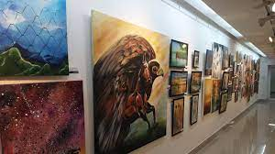
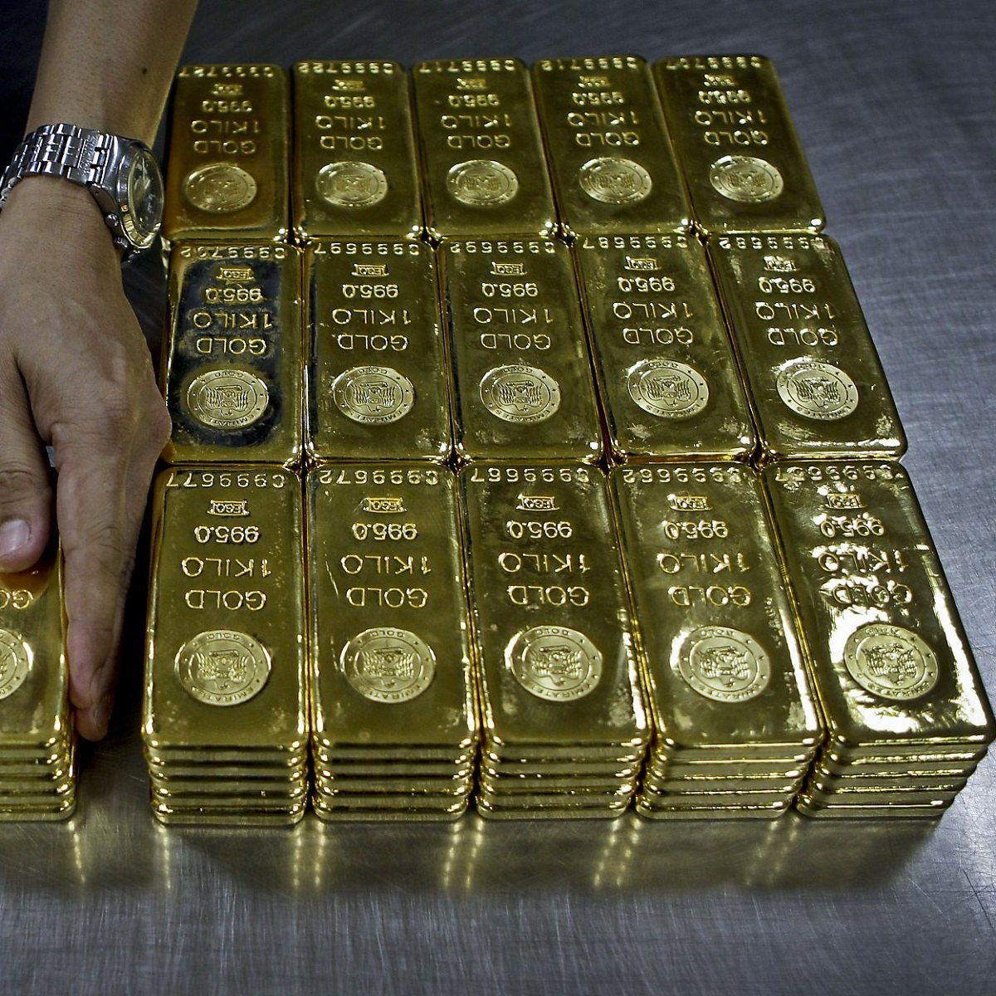


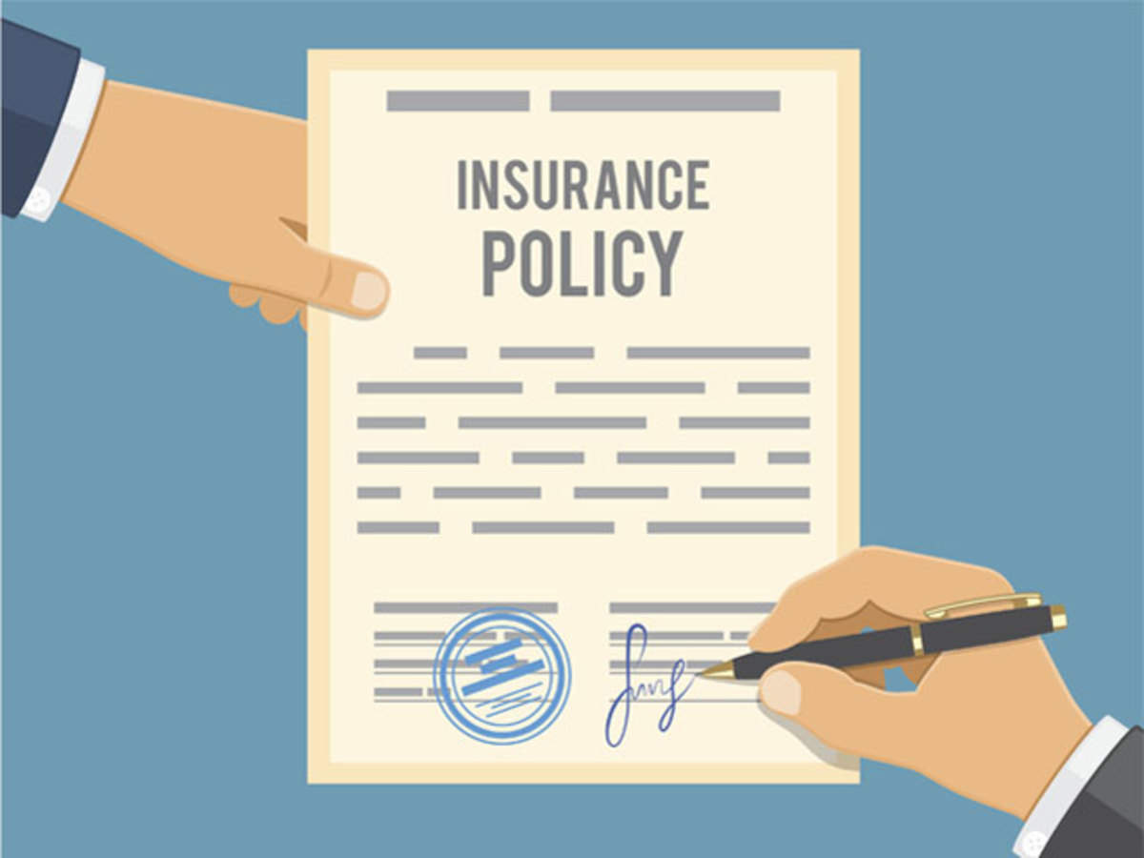
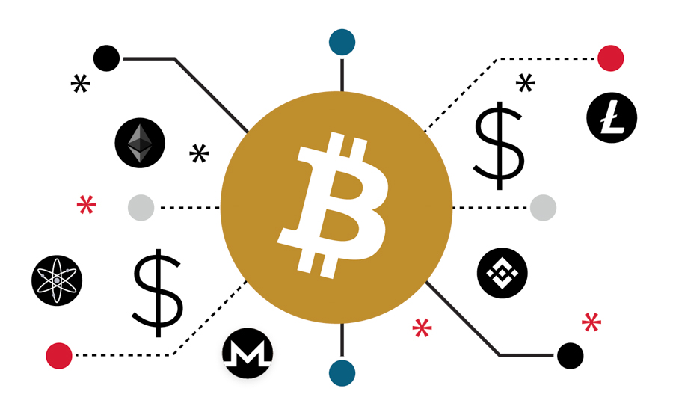
How Criminals Store Dirty Money
Precious metals, e.g., gold
Precious gems, e.g., diamonds
Stocks, bonds, investments
Cryptocurrency
Real estate
Insurance policies
Luxury items, e.g., art

Slide 12
U.S. v. Inniss: Money Laundering
Notes:
Wildlife trafficking differs – commonly it includes just animals, what we usually think of as wildlife.
More and more, it also includes illegal logging and timber trafficking due to the impact habitat loss has on species.
Some people also include IUU fishing
Bundle all of that up and the benefit to criminal organizations from illegal wildlife, timber, and fishing is between $25-50 billion dollars.
This seems like a small sum compared to many of the crimes you address, but it’s still a large amount that can be used to finance more lucrative criminal ventures.
This is an important point… enforcement in the major hotspots for these crimes – Africa, Asia, and South America is relatively lax and ineffective and it seems that the growth in the value of wildlife trafficking is in part due to this being “easy money” for criminal organizations.
Relatively speaking, the bases are so well covered on the drug, human trafficking, and counterfeiting fronts that wildlife crime is a low risk way for criminals to keep their operations funded.

Slide 13

Background
U.S. v. Inniss
Insurance company (ICBL) found unusual payment to government minister, so began internal investigation
Notified Department of Justice
Payments went through Brooklyn, NY
Get financial records
    Bank records
    Wire transfers
    Mortgage loans
    Dental Lab records
Notes:
Wildlife trafficking differs – commonly it includes just animals, what we usually think of as wildlife.
More and more, it also includes illegal logging and timber trafficking due to the impact habitat loss has on species.
Some people also include IUU fishing
Bundle all of that up and the benefit to criminal organizations from illegal wildlife, timber, and fishing is between $25-50 billion dollars.
This seems like a small sum compared to many of the crimes you address, but it’s still a large amount that can be used to finance more lucrative criminal ventures.
This is an important point… enforcement in the major hotspots for these crimes – Africa, Asia, and South America is relatively lax and ineffective and it seems that the growth in the value of wildlife trafficking is in part due to this being “easy money” for criminal organizations.
Relatively speaking, the bases are so well covered on the drug, human trafficking, and counterfeiting fronts that wildlife crime is a low risk way for criminals to keep their operations funded.

Slide 14
Fake Invoice - #1
U.S. v. Inniss
Notes:
Wildlife trafficking differs – commonly it includes just animals, what we usually think of as wildlife.
More and more, it also includes illegal logging and timber trafficking due to the impact habitat loss has on species.
Some people also include IUU fishing
Bundle all of that up and the benefit to criminal organizations from illegal wildlife, timber, and fishing is between $25-50 billion dollars.
This seems like a small sum compared to many of the crimes you address, but it’s still a large amount that can be used to finance more lucrative criminal ventures.
This is an important point… enforcement in the major hotspots for these crimes – Africa, Asia, and South America is relatively lax and ineffective and it seems that the growth in the value of wildlife trafficking is in part due to this being “easy money” for criminal organizations.
Relatively speaking, the bases are so well covered on the drug, human trafficking, and counterfeiting fronts that wildlife crime is a low risk way for criminals to keep their operations funded.

Slide 15
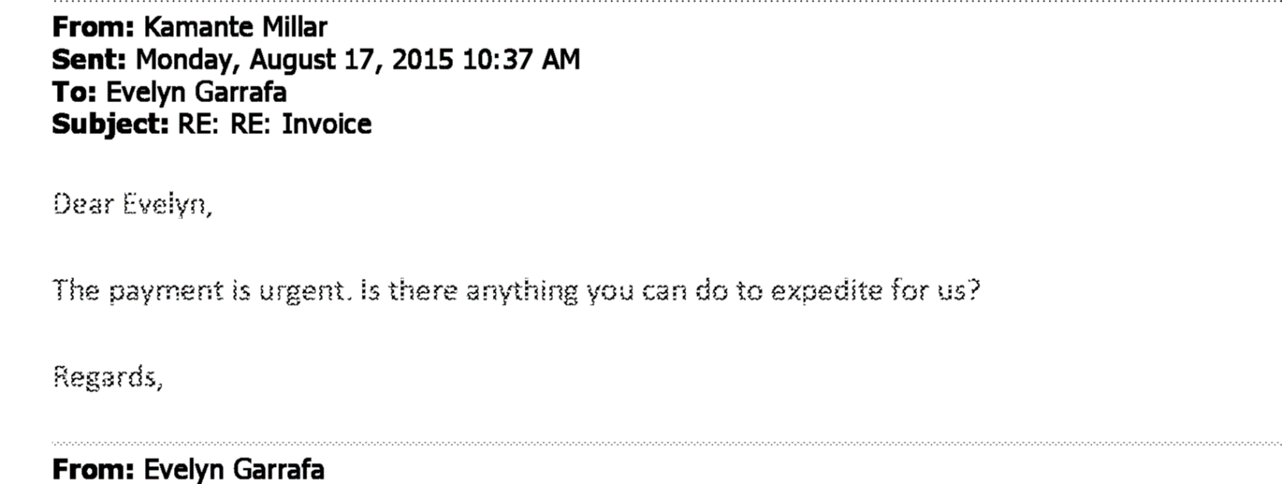
Pushing through fake invoice
U.S. v. Inniss
Notes:
Wildlife trafficking differs – commonly it includes just animals, what we usually think of as wildlife.
More and more, it also includes illegal logging and timber trafficking due to the impact habitat loss has on species.
Some people also include IUU fishing
Bundle all of that up and the benefit to criminal organizations from illegal wildlife, timber, and fishing is between $25-50 billion dollars.
This seems like a small sum compared to many of the crimes you address, but it’s still a large amount that can be used to finance more lucrative criminal ventures.
This is an important point… enforcement in the major hotspots for these crimes – Africa, Asia, and South America is relatively lax and ineffective and it seems that the growth in the value of wildlife trafficking is in part due to this being “easy money” for criminal organizations.
Relatively speaking, the bases are so well covered on the drug, human trafficking, and counterfeiting fronts that wildlife crime is a low risk way for criminals to keep their operations funded.

Slide 16
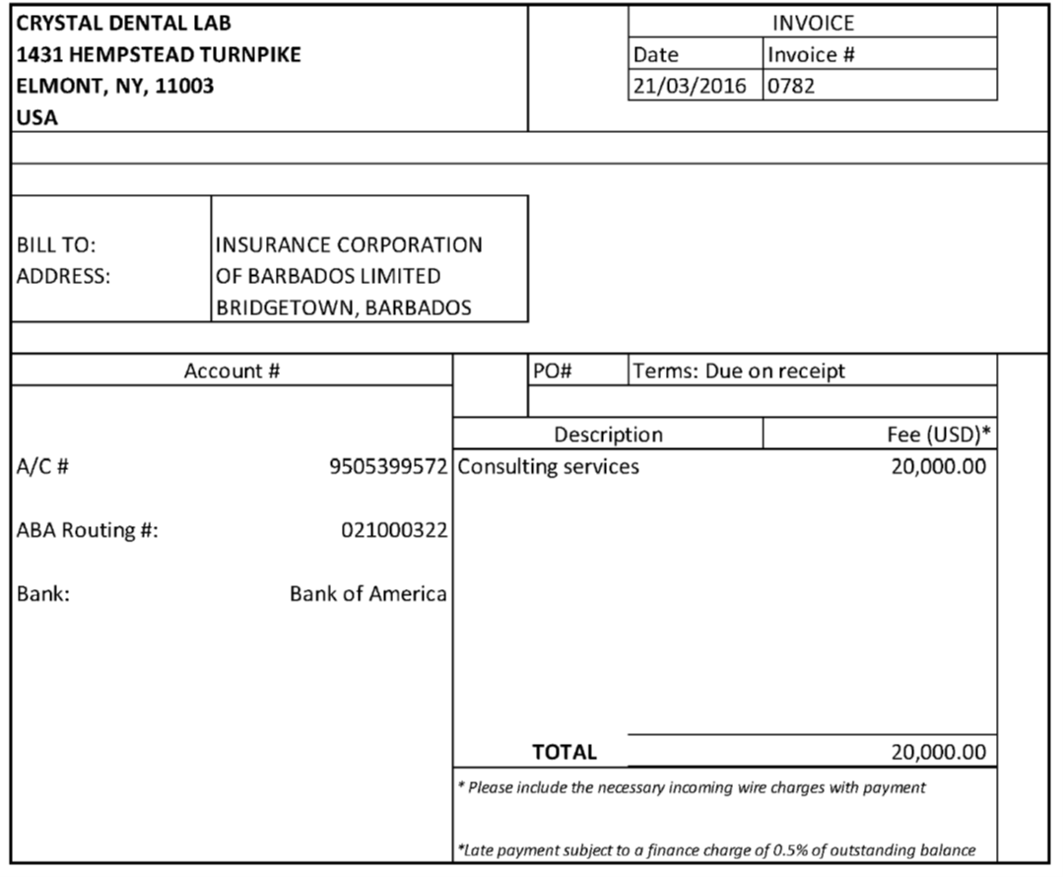
Fake Invoice - #2
U.S. v. Inniss
Notes:
Wildlife trafficking differs – commonly it includes just animals, what we usually think of as wildlife.
More and more, it also includes illegal logging and timber trafficking due to the impact habitat loss has on species.
Some people also include IUU fishing
Bundle all of that up and the benefit to criminal organizations from illegal wildlife, timber, and fishing is between $25-50 billion dollars.
This seems like a small sum compared to many of the crimes you address, but it’s still a large amount that can be used to finance more lucrative criminal ventures.
This is an important point… enforcement in the major hotspots for these crimes – Africa, Asia, and South America is relatively lax and ineffective and it seems that the growth in the value of wildlife trafficking is in part due to this being “easy money” for criminal organizations.
Relatively speaking, the bases are so well covered on the drug, human trafficking, and counterfeiting fronts that wildlife crime is a low risk way for criminals to keep their operations funded.

Slide 17
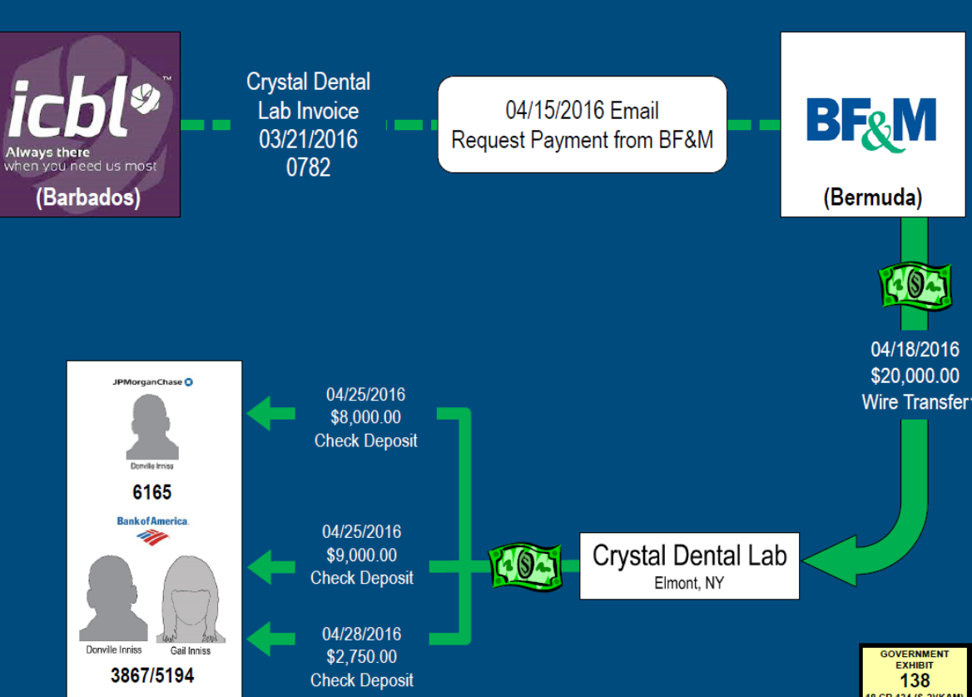
Summary chart following money
U.S. v. Inniss
Notes:
Wildlife trafficking differs – commonly it includes just animals, what we usually think of as wildlife.
More and more, it also includes illegal logging and timber trafficking due to the impact habitat loss has on species.
Some people also include IUU fishing
Bundle all of that up and the benefit to criminal organizations from illegal wildlife, timber, and fishing is between $25-50 billion dollars.
This seems like a small sum compared to many of the crimes you address, but it’s still a large amount that can be used to finance more lucrative criminal ventures.
This is an important point… enforcement in the major hotspots for these crimes – Africa, Asia, and South America is relatively lax and ineffective and it seems that the growth in the value of wildlife trafficking is in part due to this being “easy money” for criminal organizations.
Relatively speaking, the bases are so well covered on the drug, human trafficking, and counterfeiting fronts that wildlife crime is a low risk way for criminals to keep their operations funded.

Slide 18

Importance of Asset Recovery
Prevents criminals from enjoying money after their sentences
Avoids money funding other illegal activities
Puts organized crime syndicates out of business
Deters other criminals
Helps keep countries off of the FATF grey list

Slide 19
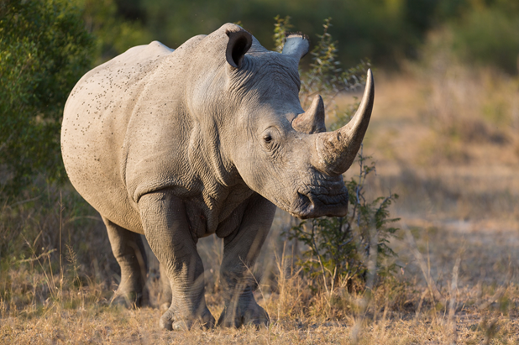
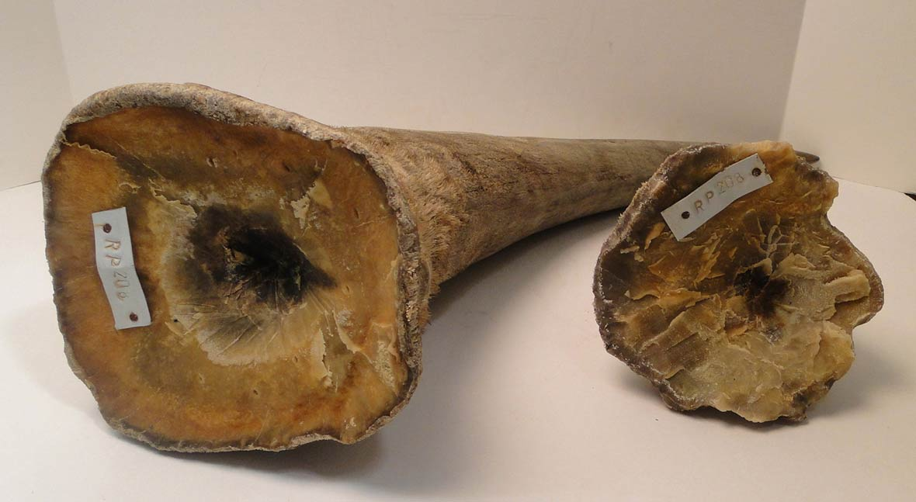
Species Victim Impact Statements
Assist valuation
Commercial value of trafficked animal
Black market value of trafficked animal
Overall harm to species
Harm to environment, habitat

Slide 20
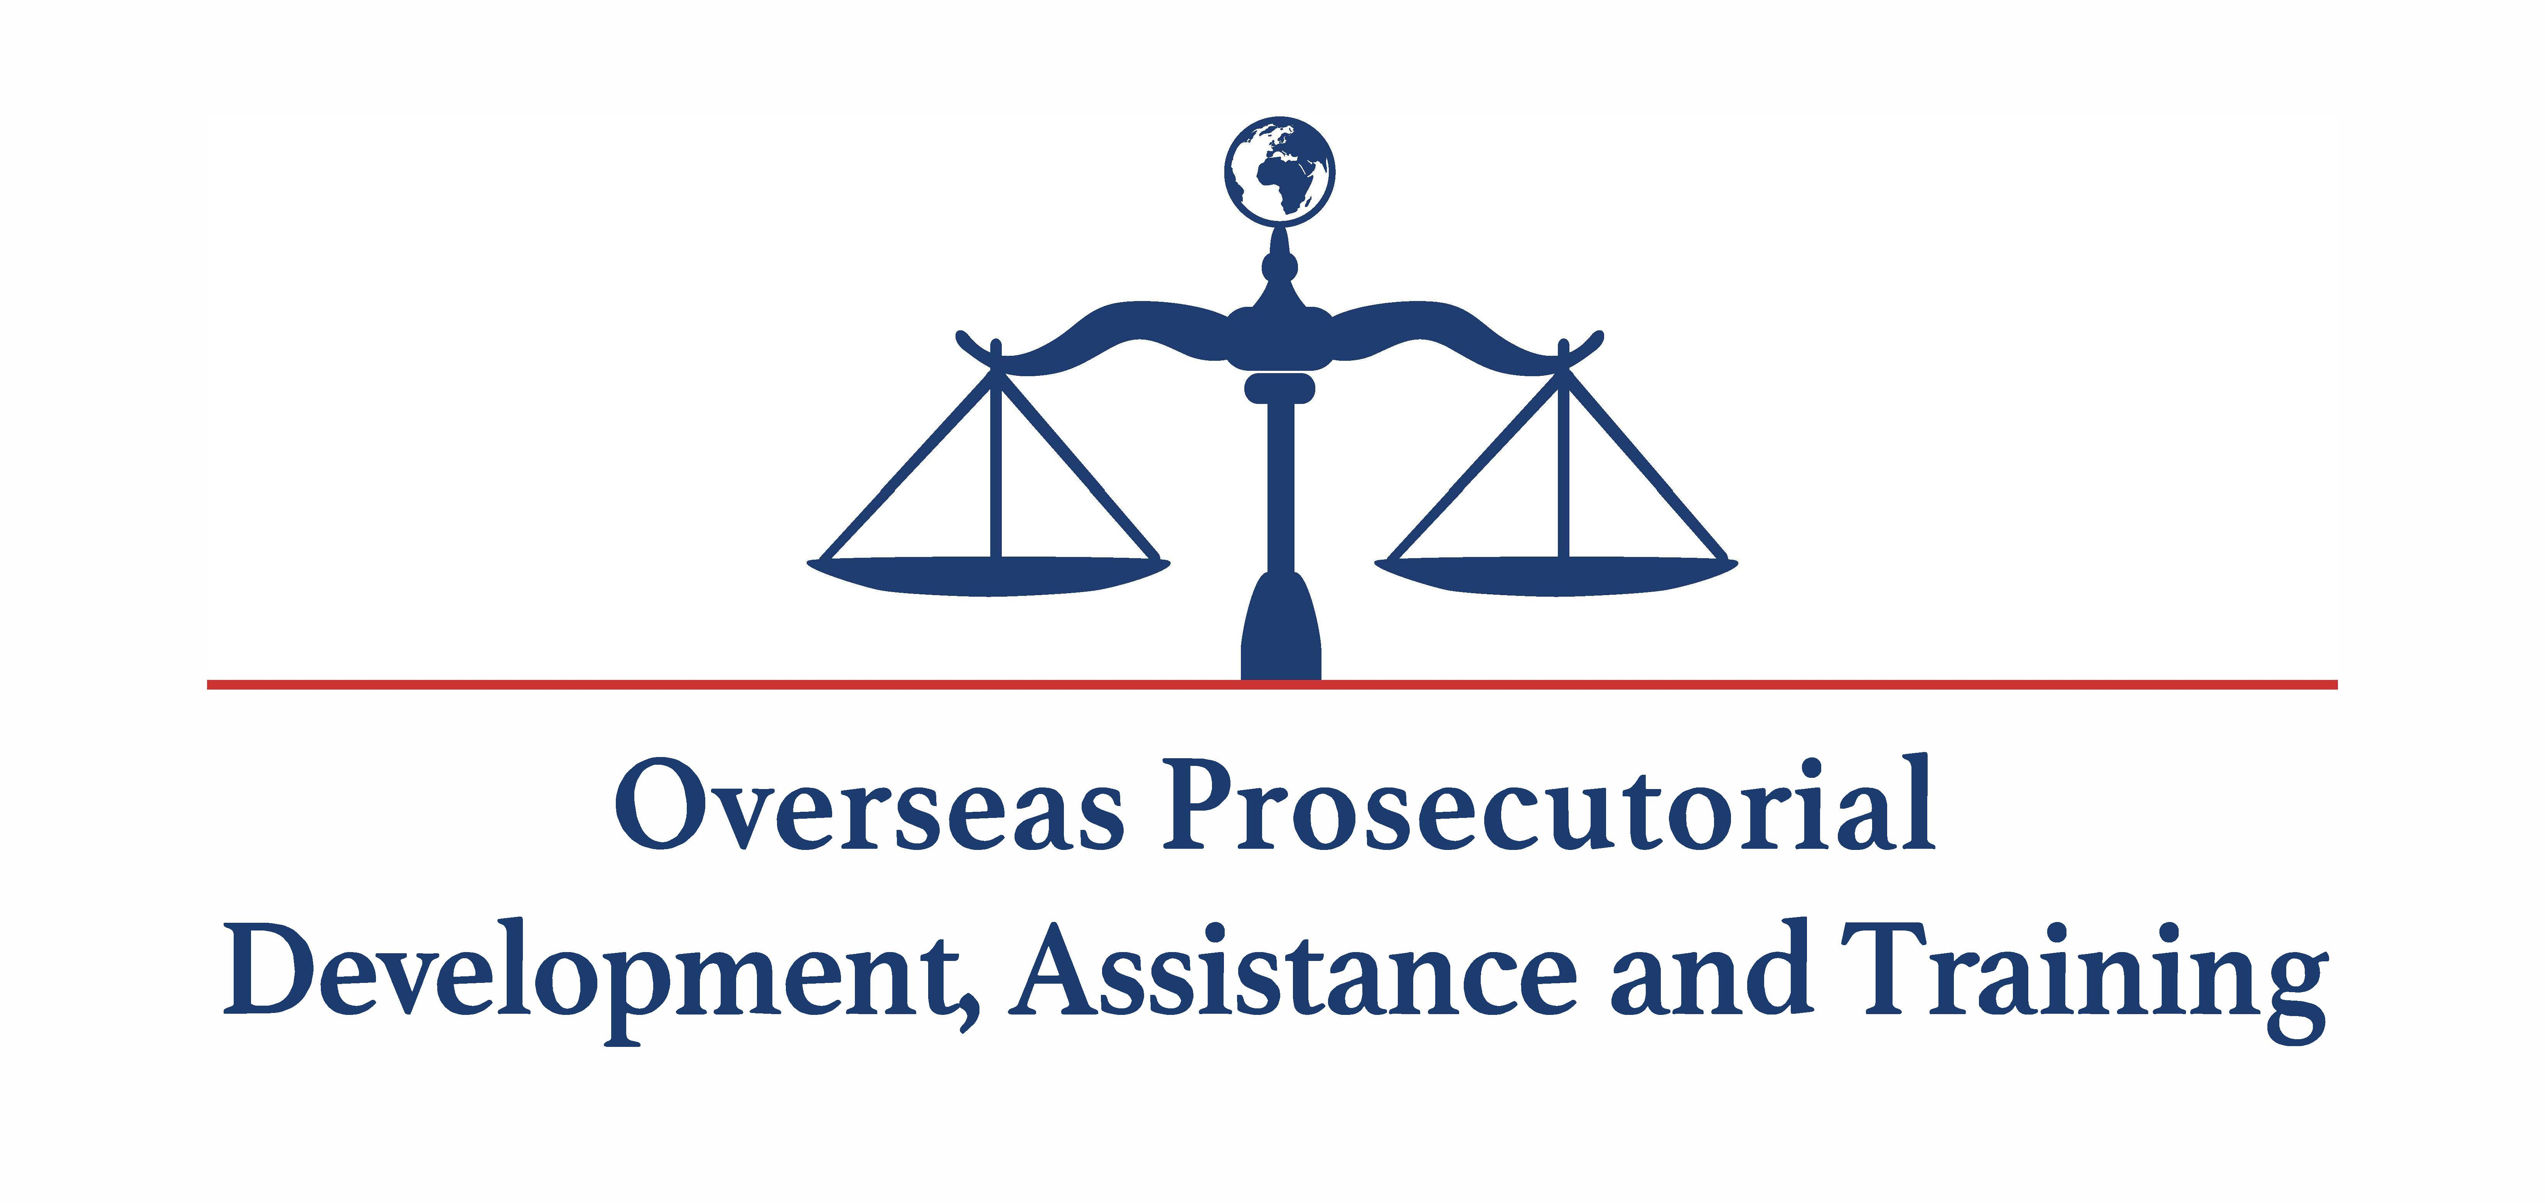
Contact
Sylvia Shweder
Counter Wildlife Trafficking Resident Legal Advisor
ShwederS@state.gov

