Slide 1
Using Species Victim Impact Statements to Effectively Address Wildlife Crime
Professor Amanda Whitfort
The University of Hong Kong

Slide 2
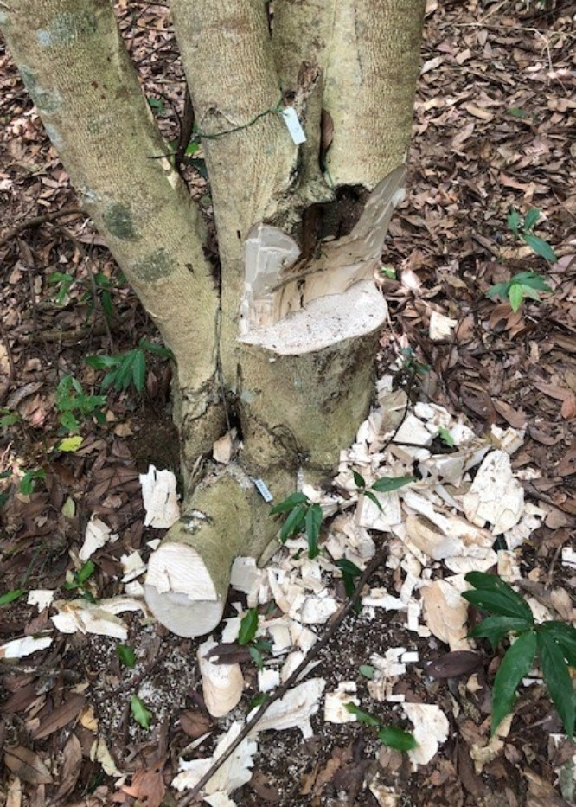
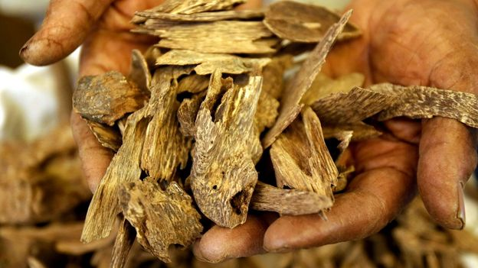
Deterrent Sentencing in Hong Kong: The incense tree cases
HKSAR v Xie Jinbin; Hong Kong Court of Appeal Case 195/2010
Protection through deterrence is the primary sentencing aim.
Unlike in theft cases, restitution is not possible- the harm caused to endangered species and ecosystem cannot be restored. The sentencing focus must therefore be on their protection.
HKSAR Wang Quanwen; Hong Kong Court of Appeal Case 263/2104
The vulnerability of the tree provides the impetus for the courts to use their sentencing powers to protect the trees and preserve the future of the species through deterrent sentencing.

Slide 3
Judicial Training
In 2018 with new maximum penalties, the Hong Kong Judicial Institute has sought guidance on the laws relating to wildlife crimes and the impact of these crimes.
Relevancy of harms caused to species and ecosystems recognised in HK in HKSAR v Wang (Hong Kong Court of Appeal 263/2014).
Need for harms to be described to judges in a way that provides reliable scientific evidence without necessarily calling an expert witness: The SVIS initiative.
https://www.svis.law.hku.hk

Slide 4
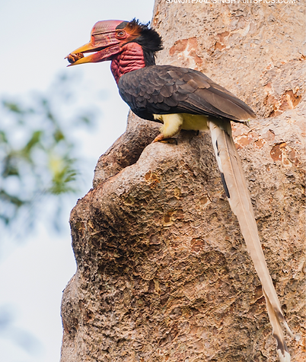
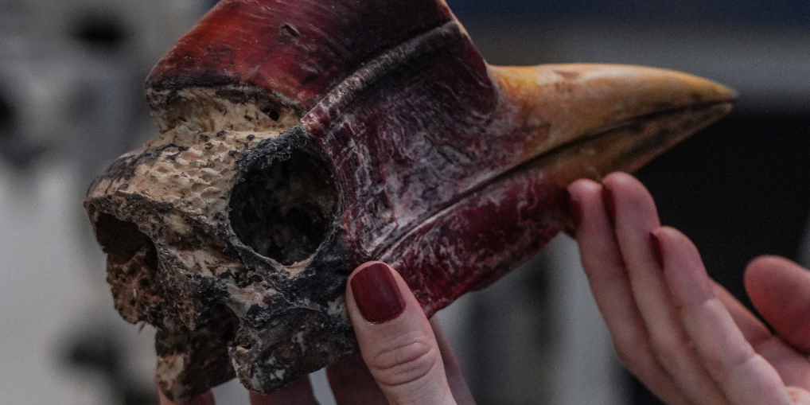
Developing the Species Victim Impact Statements
Drafted in accordance with established rules of evidence in criminal courts
Provide prosecutors with reliable and scientific data for use at trial and during case preparation
Provide a Standard format which allows data to be stored, reviewed and updated by our team at HKU and government departments
Provides information on common target species and species that regularly turn up in illegal wildlife trade
Provide evidence of impact on a particular species both within and outside the jurisdiction, and up to date trade values for species on the black market

Slide 5
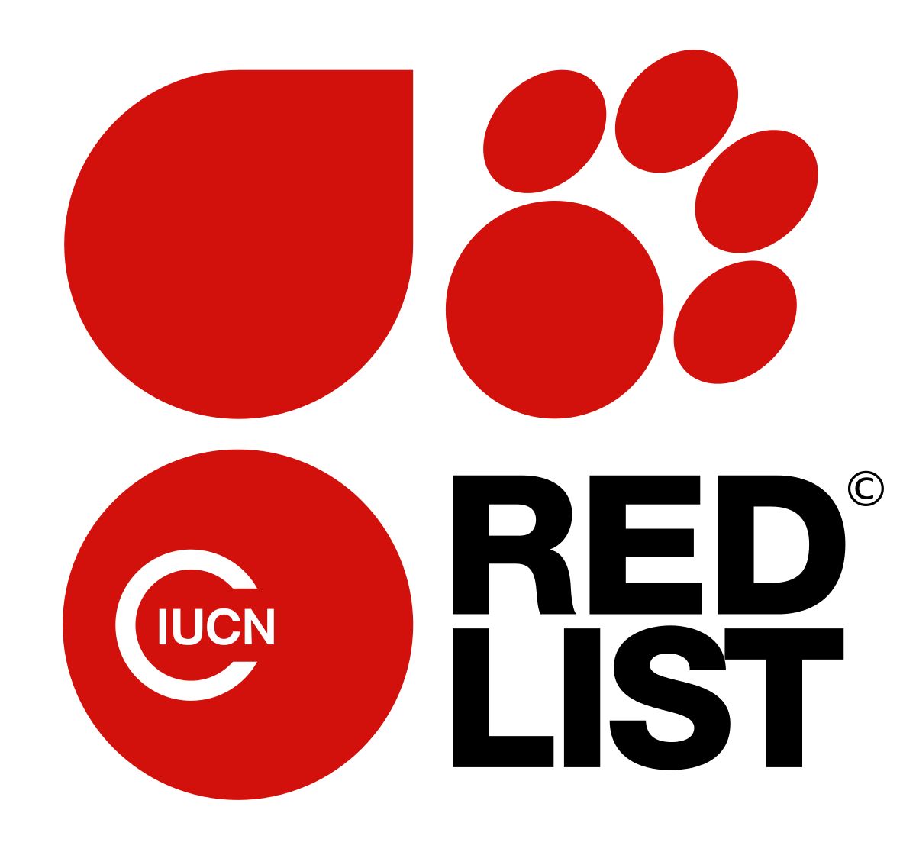
Content of the Species Victim Impact Statements
Conservation status (IUCN Red Data list, CITES Appendix I or II, etc.)
Ecosystem impacts (as a result of removal)
Keystone species (potential tipping points)
Community impacts (loss and exploitation, culture)
Population depletion and future concerns (gene pools)
Food chain effects (imbalance, commercial impacts)
Monetary value on the black market (profit margins)
Evidence of laundering of species (links with other crime)
Welfare concerns regarding live species (mode of trafficking)
Invasive Species concerns
Disease and Pathogen concerns (welfare of individuals, human risk)
Forensic Tests available to assist prosecutions

Slide 6
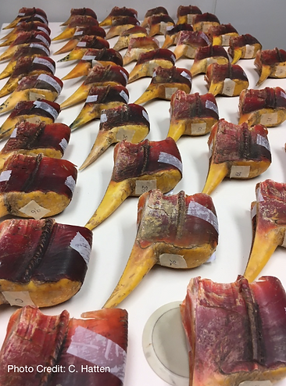
Introducing information from Species Victim Impact Statements
Through use by Prosecutors in Opening Statements for a contested trial
As agreed material in a trial or plea of guilty
Through direct handing up of the SVIS to judges to inform their sentencing
Through calling the expert witnesses listed in the last section of each SVIS.
All experts listed have agreed to provide expert evidence, if requested to do so

Slide 7
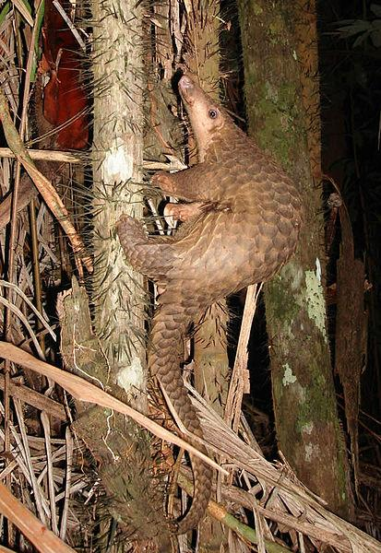
SUNDA PANGOLIN
Scientific Name | Manis javanica The Sunda Pangolin was transferred from CITES Appendix II to Appendix I in 2017.
Common Name(s) | Sunda Pangolin, Malayan Pangolin (English) 馬來穿山甲, 爪哇穿山甲 (Chinese)
Specimens Description e.g. live, skin, carcass | In trade as separate body scales, live animals, skins, frozen carcasses and sometimes stuffed specimens and trinkets/souvenirs
Quantity e.g. head, weight(kg) | Seizures of carcasses and scales often measured in tonnes. 1000kg of scales is approximately equal to 2,777 pangolins. Globally, the total amount of pangolin scales seized increased from 25.1 tons in 2016 to 81.1 tons in 2019, while the average weight of a shipment of scales increased from 2.2 tons to 6.2 tons.

Slide 8
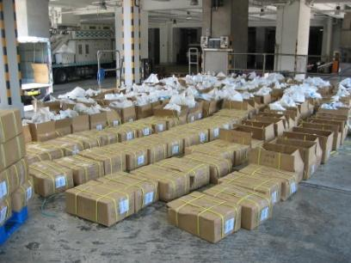
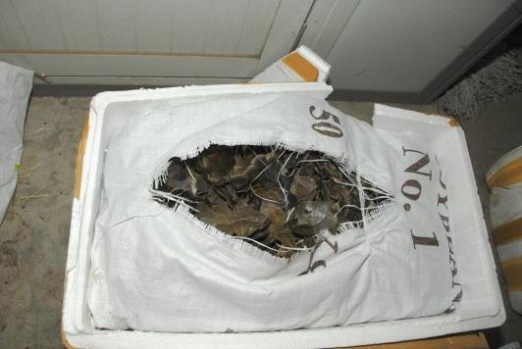
SUNDA PANGOLIN - Retail Prices in China
Meat/whole animal: US$200-297/kg (Zhou et al. 2014; Challender et al. 2015)
Scales: US$600-769/kg (Zhou et al. 2014; Challender et al. 2015)
In criminal prosecutions in Mainland China in 2020, the courts have established the value of confiscated scales at 5,300 yuan per kilo to 900 yuan per kilo, depending on the province.
The price of processed pangolin scales, a traditional Chinese medicine, varies between 7,000 and 14,000 yuan per kilo in Mainland China.
Scales of pangolin of different species are often mixed together when smuggled making the consignment documents often false or not exact.
Asian pangolin species are often mixed with African species, providing evidence of organized crime.

Slide 9
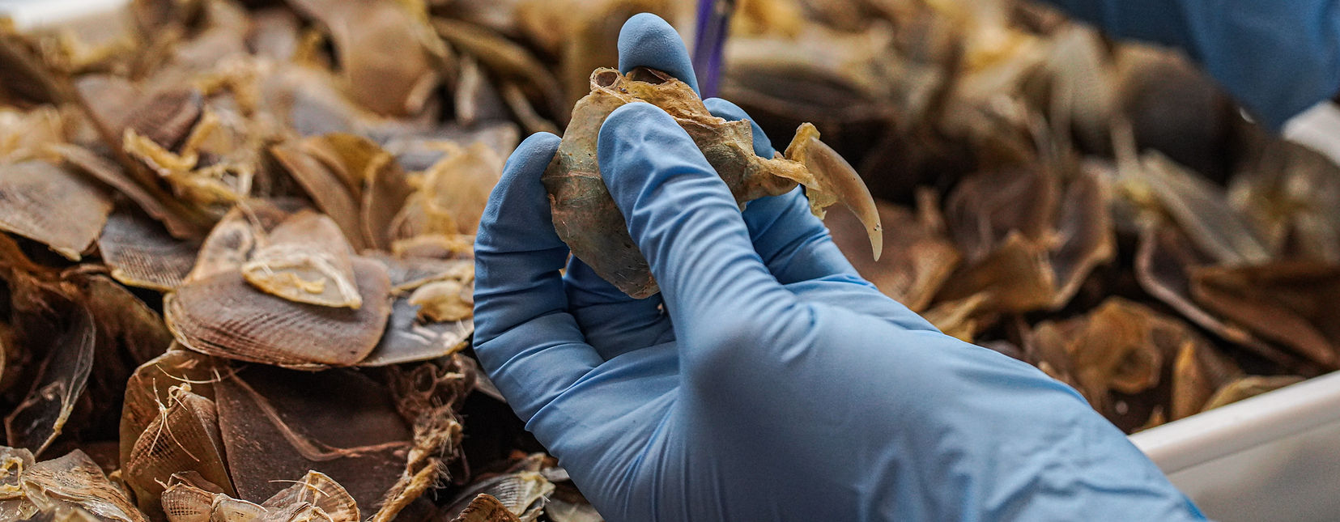
SUNDA PANGOLIN
IUCN Red List Category - Critically Endangered |  | CITES Appendix - I
Country of Origin (Natural Range) | Brunei, Cambodia, Indonesia, Laos, Malaysia, Myanmar, Singapore, Thailand, Vietnam
Major Threat(s) | The primary threat to this species is hunting and poaching, both targeted and untargeted, for local as well as international trade, which is now driven largely by market demand in China and Viet Nam.
Notes:
Major threats - Heavy trade exists despite the introduction of CITES zero export quotas for wild-caught animals traded commercially in the year 2000 (Newton et al. 2008). Within the last decade, trade in this species is estimated to have involved a minimum of 200,000 individuals (Challender et al. 2015) and market demand in China, where pangolin meat is consumed as a luxury product and its scales used in traditional medicines, appears to be driving trade (Wu and Ma 2007, Zhang et al. 2008, Challender et al. 2015).
In China, pangolin meat is consumed conspicuously as a luxury wild meat dish for which affluent consumers are willing to pay high prices.
This species also appears in both Chinese and Vietnamese traditional medicinal literature which prescribes the use of scales in traditional medicines to treat skin conditions, improve blood circulation and to stimulate milk secretion in lactating women (Ellis 2005).

Slide 10
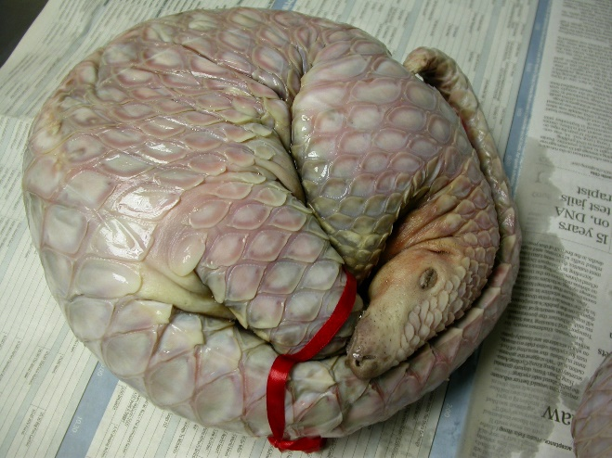
SUNDA PANGOLIN - Major Impacts
Ecosystem Impacts
Pangolin feed on ants and termites and be prey to large carnivores such as tigers, pythons and leopards. Loss of pangolin populations would result in the disruption of the energy cycle of the ecosystem. Attempts to establish captive bred pangolin populations to save the species have been unsuccessful as pangolins are extremely difficult to both maintain in captivity and to breed.
Welfare Concerns
In transport, pangolins are commonly tied into sacks and must remain in the tight ball position curled into for protection on capture. They will not be provided with water or food and may travel for days before reaching final destinations which may be restaurants, markets or descaling houses.
Pathogen Concerns
Pangolins have been found to carry a coronavirus closely related to SARS-CoV-2, the virus that causes Covid-19.
Notes:
Ecosystem Impacts
The removal of large number of pangolin may result in wide effects on the ecosystems. Pangolin feed on ants and termites. Both ants and termites are considered the foundation of ecosystem functioning.
Pangolins are likely to be prey to large carnivores such as tigers, pythons and leopards. Loss of pangolin populations would result in the loss of these predators’ prey base and disruption of the energy cycle of the ecosystem.
Attempts to establish captive bred pangolin populations to save the species have been unsuccessful as pangolins are extremely difficult to both maintain in captivity and to breed.
Welfare Concerns
In transport, pangolins are commonly tied into sacks and must remain in the tight ball position curled into for protection on capture. They will not be provided with water or food and may travel for days before reaching final destinations which may be restaurants, markets or descaling houses.
Pathogen Concerns
Pangolins have been found to carry a coronavirus closely related to SARS-CoV-2, the virus that causes Covid-19. It has been suggested that pangolins may have been an intermediate host that passed the disease to humans during close contact in trade, although this direct link between pangolin coronaviruses and human SARS-CoV-2 has not been proven.

Slide 11
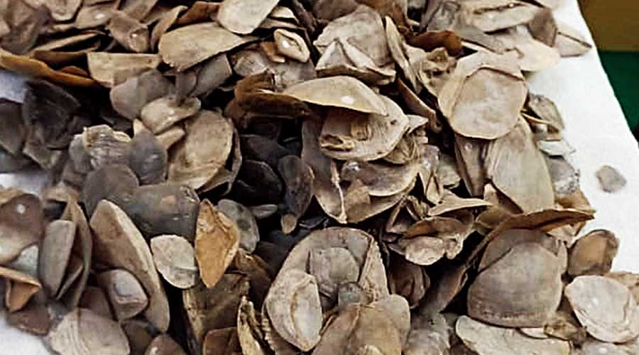
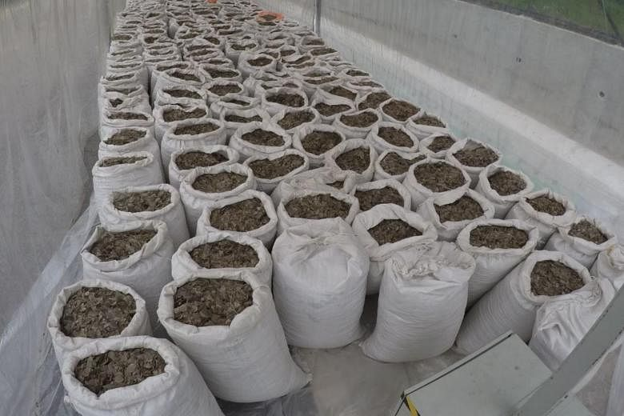
Recent Pangolin Cases
HKSAR v Huang Zengxuan DCCC240/2019, District Court of Hong Kong. In 2018, customs officers intercepted eight boxes containing 65 kg of pangolin scales and delivered them to an address under surveillance. The defendant was convicted of conspiracy to import unmanifested goods, and sentenced to 48 months’ imprisonment reduced to 32 months for pleading guilty.
Longling County court in Yunnan Province sentenced Ning Deliu to one month imprisonment and a fine of 3,000 yuan. Ning’s car was stopped at a border police checkpoint in Longling county and a bag containing 134 grams of Sunda pangolin scales was found. The value of the scales was 23,782 yuan. Case number:（2021）云0523刑初15号
Court in Guangxing City, Guangxi Autonomous Region, sentenced Vietnamese national Pham Van Vu to 3 years and a fine of 30,000 yuan for smuggling. Pham was arrested after crossing the Viet-Sino border carrying 30.15kg of scales of Sunda pangolin. The value of the scales was estimated at 562,800 yuan. Pham worked on behalf of two Chinese accomplices. Case number:（2021）桂0681刑初4号
Cuiping District Court of Yibin city, Sichuan Province, sentenced Xiong Yiping to 6 months, suspended for one year, and a fine of 2,000 yuan. Xiong was selling processed pangolin scales, in her pharmacy. She purchased them for 7 yuan per gram, and resold it for 10 -14 yuan per gram. She sold 38 grams before her arrest. Case number:（2021）川1502刑初109号
Notes:
HKSAR v Huang Zengxuan DCCC240/2019 District Court of Hong Kong. In 2018, customs officers intercepted eight boxes containing 65 kg of pangolin scales and delivered them to an address under surveillance. The defendant received the box from a room were he worked in which were found to be nine repackaged cartons containing 181.82 kg of pangolin scales; a cardboard box containing 8.08 kg of pangolin scales and an electronic balance. The defendant was convicted of conspiracy to import unmanifested goods, and sentenced to 48 months’ imprisonment reduced to 32 months for pleading guilty.
Longling County court in Yunnan Province sentenced Ning Deliu to one month imprisonment and a fine of 3,000 yuan. Ning’s car was stopped at a border police checkpoint in Longling county and a bag containing 134 grams of Sunda pangolin scales was found. The value of the scales was 23,782 yuan. Case number:（2021）云0523刑初15号
Court in Guangxing City, Guangxi Autonomous Region, sentenced Vietnamese national Pham Van Vu to 3 years and a fine of 30,000 yuan for smuggling. Pham was arrested after crossing the Viet-Sino border carrying 30.15kg of scales of Sunda pangolin. The value of the scales was estimated at 562,800 yuan. Pham worked on behalf of two Chinese accomplices.
Case number:（2021）桂0681刑初4号
Cuiping District Court of Yibin city, Sichuan Province, sentenced Xiong Yiping to 6 months, suspended for one year, and a fine of 2,000 yuan. Xiong was selling processed pangolin scales, in her pharmacy. She purchased them for 7 yuan per gram, and resold it for 10 -14 yuan per gram. She sold 38 grams before her arrest. Case number: （2021）川1502刑初109号

Slide 12
Further Expert Comment and References
Dr Gary Ades, Head of Fauna, Kadoorie Farm and Botanic Gardens , Hong Kong.
Challender D, Nguyen Van T, Shepherd C, Krishnasamy K, Wang A, Lee B, Panjang E, Fletcher L, Heng S, Seah Han Ming J, Olsson A, Nguyen The Truong A, Nguyen Van Q, Chung Y. 2014. Manis javanica. The IUCN Red List of Threatened Species 2014: e.T12763A45222303. http://dx.doi.org/10.2305/IUCN.UK.2014-2.RLTS.T12763A45222303.en.
Challender, D.W.S., Harrop, S.R., MacMillan, D.C., 2015. Understanding markets to conserve trade-threatened species in CITES. Biol. Cons. 187, 249–259.
Griffiths, Hannah M ; Ashton, Louise A ; Walker, Alice E ; Hasan, Fevziye ; Evans, Theodore A ; Eggleton, Paul ; Parr, Catherine L ; Sanders, Nate. 2018. Ants are the major agents of resource removal from tropical rainforests. The Journal of animal ecology, Vol.87 (1), p.293-300
Yan, Dingyu ; Zeng, Xiangyan ; Jia, Miaomiao ; Guo, Xiaobing ; Deng, Siwei ; Tao, Li ; Huang, Xiaolu ; Li, Baocai ; Huang, Chang ; Que, Tengcheng ; Li, Kaixiang ; Liang, Wenhui ; Zhao, Yao ; Liang, Xingxing ; Zhong, Yating ; Platto, Sara ; Choo, Siew Who. 2021. Successful captive breeding of a Malayan pangolin population to the third filial generation. Communications biology, Vol.4 (1), p.1212-1212
Zhou, Z.M., Zhou, Y., Newman, C., Macdonald, D.W., 2014. Scaling up pangolin protection in China. Front. Ecol. Environ. 12, 97–98.

Slide 13
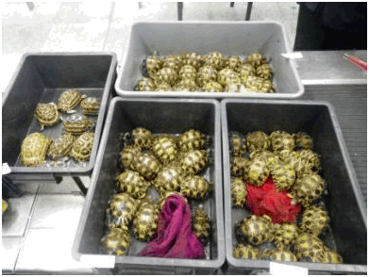
Market value of TURTLES to collector
Type | Price | CITES Appendix | IUCN
Astrochelys radiate (Radiated Tortoise) | HK$5,000-13,000 (depending on age) | I | CR
Astrochelys yniphora (Ploughshare Tortoise or Madagascar tortoise) | US$1,000 per cm (Shell length) | I | CR
Cuara mccordi (McCord’s Box Turtle) | US$16,667 | II | CR
Geoclemys hamiltonii (Black Pond Turtle) | US$159-995 (depending on size) | I | VU
Siebenrockiella leytensis (Palawan Forest Turtle) | HK$14,000-17,000 | II | CR
Pyxis arachnoides (Spider Tortoise) | HK$6,800 | I | CR

Slide 14
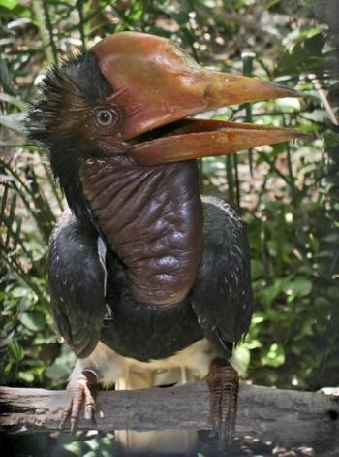
Helmeted Hornbill (Rhinoplax vigil)
Specimens Description e.g. live, skin, carcass | Only the large and solid casque (mainly the upper mandible, but sometimes the whole skull) is traded. In the trade the species is known as hornbill ivory, golden jade, 鶴頂紅, or 紅象牙. It is carved into different items (rings, decorations, pendant, beads, etc.), much like ivory.
Quantity e.g. head, weight(kg) | In Mainland China, seizures of over 100 casques are made, often together with other high-value wildlife contraband such as elephant ivory, rhino horn, hawksbill turtle shell and bear and leopard claws and teeth.
Trade Value Estimate Illegal/legal trade value | US$1,000 for a single casque (Beastall et al. 2016) In 2020 a court in Urumchi city, Xinjiang AR, valued a single casque at 8,152 yuan. Carvings made from casques were valued at 400,000 yuan by the same court.
Declared Origin of Consignment
Declared Destination of Consignment | China, Laos, Japan

Slide 15
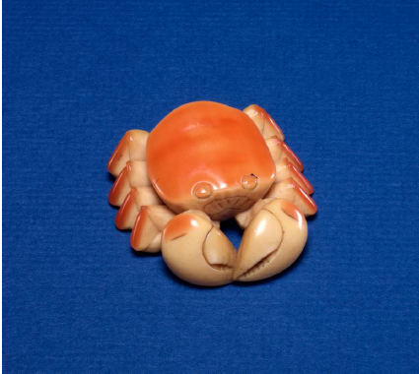
Helmeted Hornbill (Rhinoplax vigil)
IUCN Red List Category - Critically Endangered |  | CITES Appendix – I
Country of Origin (Natural Range) | Myanmar, Thailand, Malaysia, Indonesia, Brunei, Singapore (Locally extinct)
Major Threat(s) | Overexploitation for its casque, which is known as hornbill ivory or hedinghong 鶴頂紅in Chinese. The casque can weigh up to 10% of the bird’s body weight. Habitat loss from logging and conversion to palm oil plantation.
Notes | The helmeted hornbill is the largest species of hornbill in Asia. Despite being listed on CITES Appendix I since 1975, illegal trade of its casque continues to take place, and trade volume has evidently been increasing in the last decade (Beastall et al. 2016). In 2015, the species was up-listed from Near Threatened to Critically Endangered on the IUCN Red List due to severe hunting pressure for its casque and as a result of habitat loss from logging and agricultural conversion. Hunting pressure is expected to increase and spread across the species' range given the value that is placed on the casque in illegal trade. Grade 1 nationally protected species in China.

Slide 16
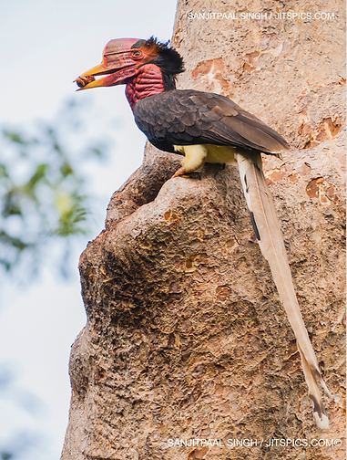
Helmeted Hornbill - Major Impacts to the countries of origin
As one of eight hornbill species native to Borneo, the species is important in the culture of many ethnic groups. It has been associated with head-hunting and the afterlife and is the state bird of Indonesia’s West Kalimantan province (Beastall et al. 2016). Hornbills eat fruit and are the largest and most effective seed dispersers in tropical forests, known as “forest engineers”. Hornbills in Asia transport seeds of over 700 species far across the forests and for facilitating forest recovery. (Kitamura, 2011). Severe population declines have been reported from most of the species range, including Sumatra, peninsula Malaysia, and most of Borneo, mainly due to poaching and habitat loss. The poaching is centered on Indonesia currently, but expansion to Malaysia is also suspected (S. Mahood per. comm. in IUCN Red List)
Notes:
As one of eight hornbill species native to Borneo, the species is important in the culture of many ethnic groups on the island. It has been associated with head-hunting and the afterlife and is the state bird of Indonesia’s West Kalimantan province (Beastall et al. 2016).
Hornbills eat fruit and are the largest and most effective seed dispersers in tropical forests, known as “forest engineers”. Hornbills are “high quality dispersers” because they eat only the fleshy part of the fruit and the seeds have short passage time in the gut. Hornbills in Asia transport seeds of over 700 species, and also spread them far across the forest and produce even spread of the seeds and new trees. (Kitamura, 2011).
Their role of forest engineers makes them an important species for facilitating forest recovery in Southeast Asia, where forests are disappearing rapidly to give way to palm plantation and agriculture conversion.
Severe population declines have been reported from most of the species range, including Sumatra, peninsula Malaysia, and most of Borneo, mainly due to poaching and habitat loss. The poaching is centered on Indonesia currently, but expansion to Malaysia is also suspected as the population declined in Indonesia (S. Mahood per. comm. in IUCN Red List
Analysis of seizure data by UK-based NGO Environmental Investigation Agency (EIA) shows at least 2,878 helmeted hornbill casques, skulls and products were seized from at least 59 known confiscations between 2010 and 2017.

Slide 17
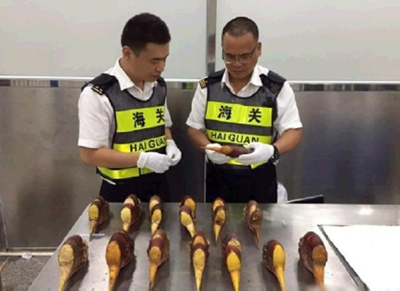
Helmeted Hornbill - Major Impacts
Seizures
Analysis of seizure data by UK-based NGO Environmental Investigation Agency (EIA) shows at least 2,878 helmeted hornbill casques, skulls and products were seized from at least 59 known confiscations between 2010 and 2017 (IUCN, 2018)
Welfare
Hunters usually target the casque bearing males, but because of the unique breeding cycle of hornbills (where females and chicks completely rely on males for up to 5 months to provide food to them while being incarcerated in tree holes), the killing of males can lead to deaths of both females and chicks.
Wildlife Forensics
Approaches to identify the origins and sex of samples based on genetic and stable isotope signatures of traded casques have been studied by the School of Biological Sciences, the University of Hong Kong.
Notes:
Most seizures occur in Indonesia (source country) and China (destination country) with poachers in Indonesia confirming the involvement of organised crime networks who also target pangolin and tiger (Beastall, 2016).Illegal hunting has led to the number of seized individuals over the past 10 years being almost 4 x higher than the number of wild individuals observed over the past 40 years.

Slide 18
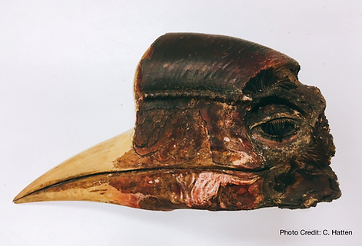
Recent Hornbill Cases using SVIS
HKSAR v Lin Jun Jie; District Court of Hong Kong Case 294/2019. In July 2019 a man was sentenced to 4 years in prison for his part in the smuggling 3 kg of hornbill (27 items) through Hong Kong.
In 2020, the Intermediate People’s Court of Bake District of Urumchi City, Xinjiang SAR, found a man guilty of transporting, purchasing and selling valuable species and products made from them, sentencing him to 10 years imprisonment and a fine of 200,000 yuan. The defendant had been involved in illegal wildlife trade, purchasing the contraband from Vietnamese sellers or from sellers in Zhuhai city in Guangdong province. He was found in possession of 6 carved items made form helmeted hornbill casque, and 184 casques.
The court valued a single casque at 8,152 yuan. Carvings made from casques were valued at 400,000 yuan. Case number: （2020）新0103刑初246号

Slide 19
Further Expert Comment and References
Dr Caroline Dingle, IUCN Hornbill Specialist Group (Helmeted Hornbill Working Group), formerly The University of Hong Kong, School of Biological Sciences Beastall C, Shepherd CR, Hadiprakarsa Y, Martyr D. 2016. Trade in the Helmeted Hornbill Rhinoplax vigil: the ‘ivory hornbill.’ Bird Conservation International 26:137-146. BirdLife International. 2016. Rhinoplax vigil. The IUCN Red List of Threatened Species 2016: e.T22682464A92947540. http://dx.doi.org/10.2305/IUCN.UK.2016-3.RLTS.T22682464A92947540.en. Downloaded on 18 May 2017. Collar NJ. 2015. Helmeted Hornbills Rhinoplax vigil and the ivory trade: the crisis that came out of nowhere. Birding ASIA 24:12-17. Kitamura S, 2011. Frugivory and seed dispersal by hornbills (Bucerotidae) in tropical forests. Acta oecologica. Vol.37 (6), p.531-541

Slide 20
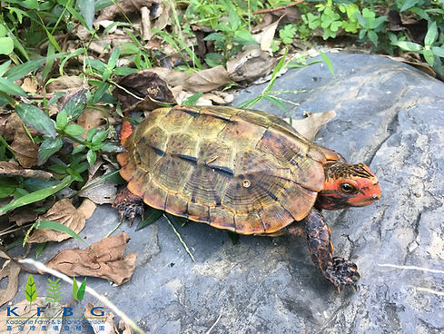
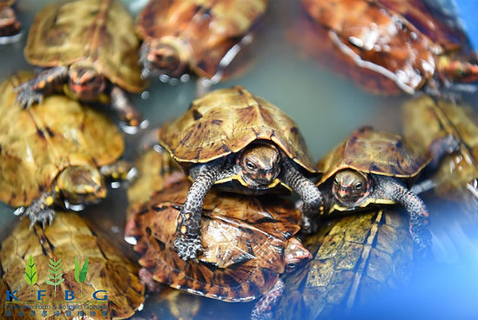
Cases for turtles pre and post-SVIS
Pre-SVIS Cases
HKSAR v Sameh and Abdelaziz Tsuen Wan Magistrates Court, 15 March 2014. Two Egyptian men were caught at the airport attempting to smuggle 128 Radiated tortoises and Spider tortoises through Hong Kong to Taiwan. They were ordered to pay a HK$40,000 and HK$45,000 fine, and sentenced to 2 months’ imprisonment, suspended for 18 months. The animals were valued at HK$759,000.
Tsuen Wan Magistracy 455/2014 (Unreported decision of the Tsuen Wan Magistrates Court, 17 March 2014). A Malagasy national was intercepted at HK airport attempting to smuggle 112 Radiated Tortoises and 10 Ploughshare (Madagascar) Tortoises into Hong Kong. He was sentenced to 6 weeks’ imprisonment for the one species and 4 weeks for the other. The two sentences were ordered to be served concurrently.
Post-SVIS Case
HKSAR v Rasolonirina Aljymi; Hong Kong District Cout Case 896/2019
On Sept 28 2019 Hong Kong Customs seized 57 live turtles (2 Ploughshare (also known as Madagascar) and 55 Radiated tortoises) with an estimated market value of $816,555 at Hong Kong International Airport. The case also involved cruelty to animals. Culprit plead guilty and was sentenced to 36 months’ imprisonment for smuggling the animals and 12 months for animal cruelty, both sentences were reduced by one third for his guilty plea.
Notes:
Pre-SVIS Cases
HKSAR v Sameh and Abdelaziz Tsuen Wan Magistrates Court, 15 March 2014
Two Egyptian men were caught at the airport attempting to smuggle 128 Radiated tortoises and Spider tortoises through Hong Kong to Taiwan. They were ordered to pay a HK$40,000 and HK$45,000 fine, and sentenced to 2 months’ imprisonment, suspended for 18 months. The animals were valued at HK$759,000. The men claimed the animals had been legally bred for export in Madagascar, despite no legal breeding facility existing for commercial trade.
Tsuen Wan Magistracy 455/2014 (Unreported decision of the Tsuen Wan Magistrates Court, 17 March 2014). A Malagasy national was intercepted at HK airport attempting to smuggle 112 Radiated Tortoises and 10 Ploughshare (Madagascar) Tortoises into Hong Kong. He was sentenced to 6 weeks’ imprisonment for the one species and 4 weeks for the other. The two sentences were ordered to be served concurrently. The estimated value of the consignment was HK$1,340,000.
Post-SVIS Case
HKSAR v Rasolonirina Aljymi; Hong Kong District Cout Case 896/2019
On Sept 28 2019 Hong Kong Customs seized 57 live turtles (2 Ploughshare (also known as Madagascar) and 55 Radiated tortoises) with an estimated market value of $816,555 at Hong Kong International Airport. The case also involved cruelty to animals. A male passenger who arrived in Hong Kong from Moroni, Comoros via Addis Ababa, Ethiopia was found with the animals wrapped in tape in his luggage. He plead guilty and was sentenced to 36 months’ imprisonment for smuggling the animals and 12 months for animal cruelty, both sentences were reduced by one third for his guilty plea.

Slide 21
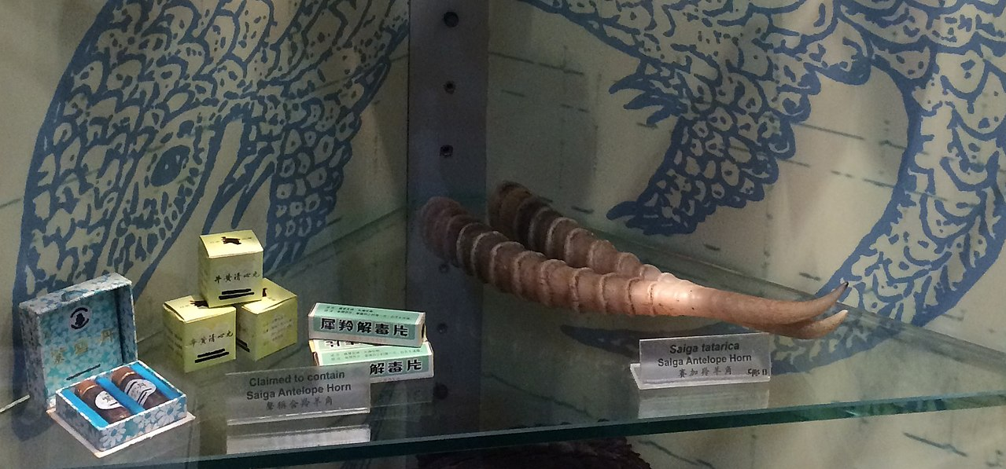
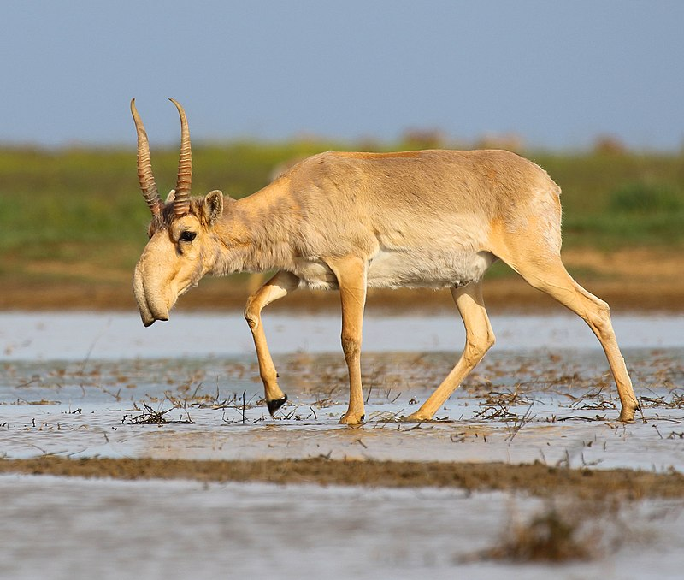
Hong Kong Court of Appeal (2021)
HKSAR v Xiao Rongquiang; Court of Appeal Case 79/2020
On November 29, 2019, Defendant arrived in Hong Kong by plane from Moscow, and customs officers seized 224 saiga antelope horns weighing 49.9 kilograms from his luggage. The horns were valued at $US100,000 to $US140,000.
The Court ruled that the crime had a great impact on the survival rate of the saiga antelope and must be deterred.
The Court upheld the original sentence of 30 months’ imprisonment and warned that if smuggling of endangered species is not deterred the courts may impose higher sentences in the future.

